Slide 1


WELCOME TO
IMI SALES ACCREDITATION
MODULE 1 & 2
Fatma Alsagaf – Learning & Development Manager

Slide 2











HOUSEKEEPING

Slide 3


YOUR SALES GROWTH JOURNEY
First Gear - Sales Induction & Probation
IMI Sales Process Module 1 & 2
IMI Sales Process Module 3 & 4
Product eLearning
IMI Sales Process Module 5 (Half day)
On the job training
Advanced Customer Communications
Coaching 1-2-1’s
IMI Sales Accreditation Assessment (In-Branch)
IMI Sales Accreditation Awards Ceremony

Slide 4
AGENDA
Welcome & Introduction
Sales Process Introduction
Lead Generation
Prospecting
Quality Lead Engagement
Generating Appointments
Qualification
My Next Development Steps

Slide 5

COURSE OBJECTIVES
What are your course objectives?
What are our course objectives?
Differentiate prospect and lead interactions
Understand the importance of a high-quality follow-up
Scheduling appointments and welcoming customers to our showrooms
Qualification Techniques
Questioning and Listening
Know you next development steps
Notes:
Reminder to the delegates to set an IDP/Goal

Slide 6
WELCOME TO THE START OF AL-FUTTAIM’S SALES PROCESS
Prospecting & Welcome
Qualification
Presentation & Demonstration
Negotiation & Closing
Great Deliveries
Follow Up & Retention
Successful businesses have one thing in common - They rely on successful operating processes – a set of standard procedures used consistently throughout their organization.
Allowing them to deliver at a consistently high level of performance and customer service time after time.
The sales process is designed to guide the sales department and the sales executive throughout the car buying journey.
Notes:
This is an overview only and brand specific processes are to be adhered too.

Slide 7

CUSTOMER BENEFITS
Builds confidence in the brand, the dealership and the Sales Executive
Delivers a consistent approach giving customers confidence to return
Provides a transparent experience building confidence the dealer has nothing to hide
Generates value and emotional attachment to the products

Slide 8

SALES EXECUTIVE BENEFITS
Maximize every potential customer in a systematic way that wins customer’s loyalty by exceeding expectations with every interaction.
Establish an environment of support and mutual understanding from peer group and dealership management
Cultivate an understanding of current performance in each of the process elements for the purposes of improvement
Improve their individual Net Promoter Score
Managers can establish accountability
Development and coaching needs can be recognised and assessed

Slide 9


DEALERSHIP/COMPANY BENEFITS
Dealership become a place where customers have a positive relationship and great memories are made
Positive word of mouth, now powered by social media, about you and your customer experience, will result in more visitors to the dealership and more opportunities for sales
Drives greater consideration for Al-Futtaim Automotive products
Promote effective, efficient and profitable return on investment
Increase loyalty and returning customer

Slide 10

1
SECTION
INTRODUCTION TO LEADS & PROSPECTS

Slide 11
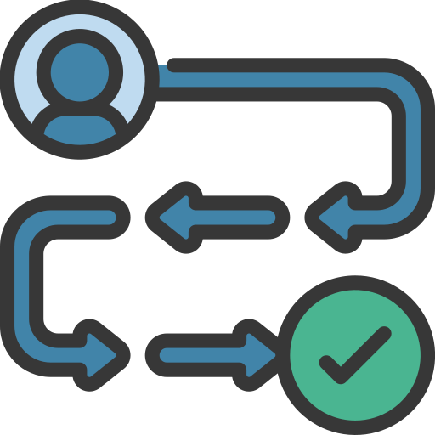
BUYERS PERSPECTIVE OF THEIR JOURNEY – RESEARCH
TRIGGER: A Call To Action
RESEARCH 1: What Is Available
BUILD A CASE: Justify The Purchase
RESEARCH 2: How Much Can I Afford
EXPERTISE: Seek Expert Advice
ACQUISITION: Complete The Purchase
Notes:
Research 1 before 2 or vice versa.

Slide 12

WHAT IS A SALES LEAD?
How to identify a sales lead:
Someone who has engaged with marketing efforts or various types of outreach that that highlights our products or services
We might not know what all of their wants and needs are
We can attribute the customer to a lead source
Lead will be received early in the car buying process and could be the first interaction for a potential customer with our brands
Additional customer information will more than likely be needed for us to qualify and convert

Slide 13
WHAT ARE SOME EXAMPLES OF LEAD SOURCES?
Leads can be generated from:
Email
Billboards
Print
Radio
WhatsApp
Website Banners
Events
TV
Video
Online Advertising
Outbound Calls
Social Media
Search
Dealer Website

Slide 14
WHAT IS A PROSPECT?
How to identify a prospect:
A lead that has met our qualifying criteria:
The customer has shown interest in our products or services
Two-way communication happened between you and the potential customer (email, phone, in-person, WhatsApp)
We have established initial wants and needs
A prospect can also be:
One of our current customers
An exciting service customer
Referrals

Slide 15

SALES PROSPECTING
Sales prospecting explained
Set of actions aimed at initiating and qualifying new business opportunities
Identifying potential customers and nurturing them
Why we need to prospect
Prospecting produces a constant flow of future customers for us to target
The larger our customer & prospect base the greater the opportunity to achieve our targets
The great salesmen in our industry prospect, so we should as well

Slide 16
WHO ARE YOUR PROSPECTS?
EXISTING CUSTOMERS
Established relationship
Knowledge about brand & product
Personal insights
Cost-effectiveness
SERVICE CUSTOMERS
We have knowledge about their current vehicle
Creating a seamless experience
Customer has familiarity with brand & product
Opportunity to start process early
REFERRALS
Trust and Credibility
Long-Term Customer Loyalty
Higher Conversion Rates
Cost-Effectiveness
Automated outreach (Digital advertising e.g.)

Slide 17
SALES PROSPECTING VS. LEAD GENERATION
LEAD GENERATION
Someone contacting us
Led by marketing Efforts
Interest has been expressed
Focus on brand and product awareness
Reactive outreach (Digital advertising e.g.)
SALES PROSPECTING
You contacting the customer
Outreach to qualified as potential customers
Led mostly by Sales Executive
Focus on customers’ specific wants and needs
Proactive Personalized outreach

Slide 18
2
SECTION
LEAD GENERATION

Slide 19
CUSTOMER RESEARCH
A study by Google shows that 95% of vehicle buyers research their next car online rather than visiting the dealership in person.
Customer will do most of their vehicle research and comparison online
Websites become virtual showrooms, and videos become virtual test drives
Customers can even narrow down financing and purchase options
How are customers submitting leads to your showroom?

Slide 20
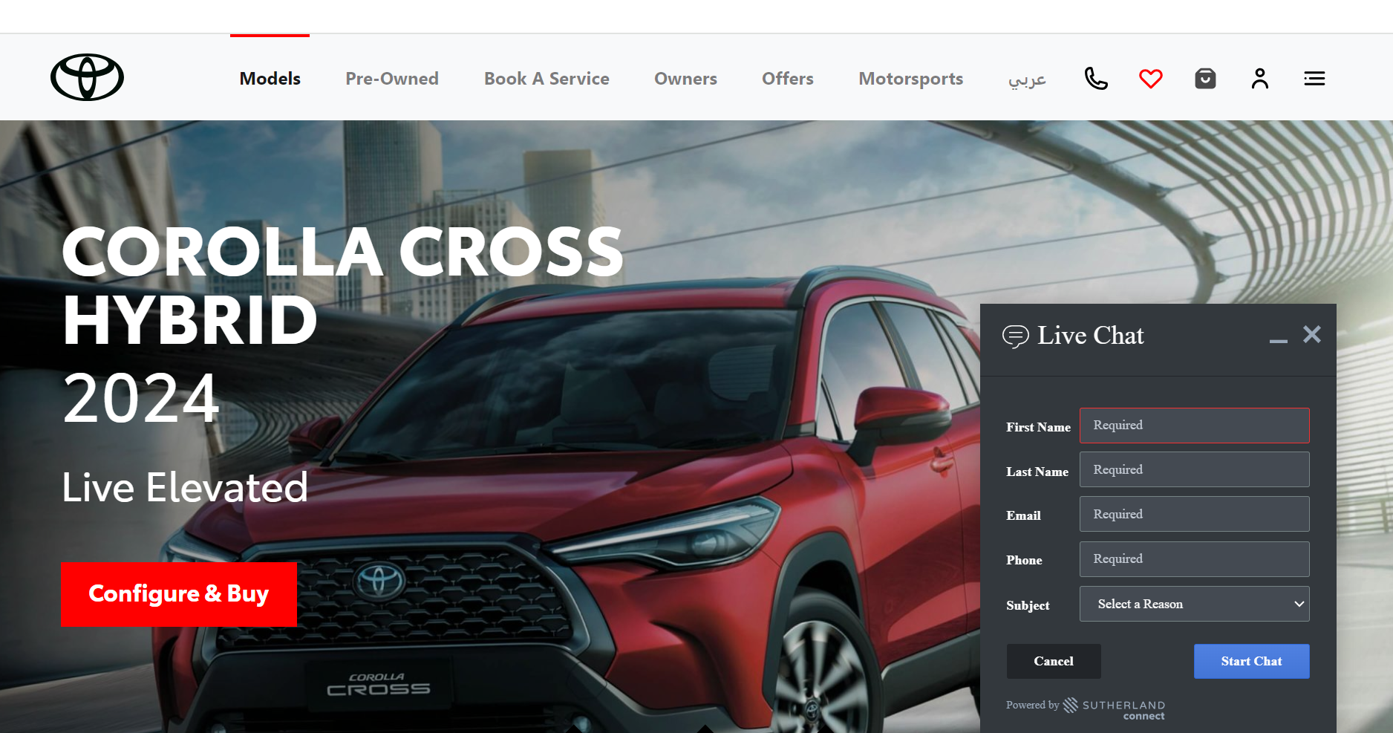
EXAMPLES OF LEAD SOURCES

Slide 21
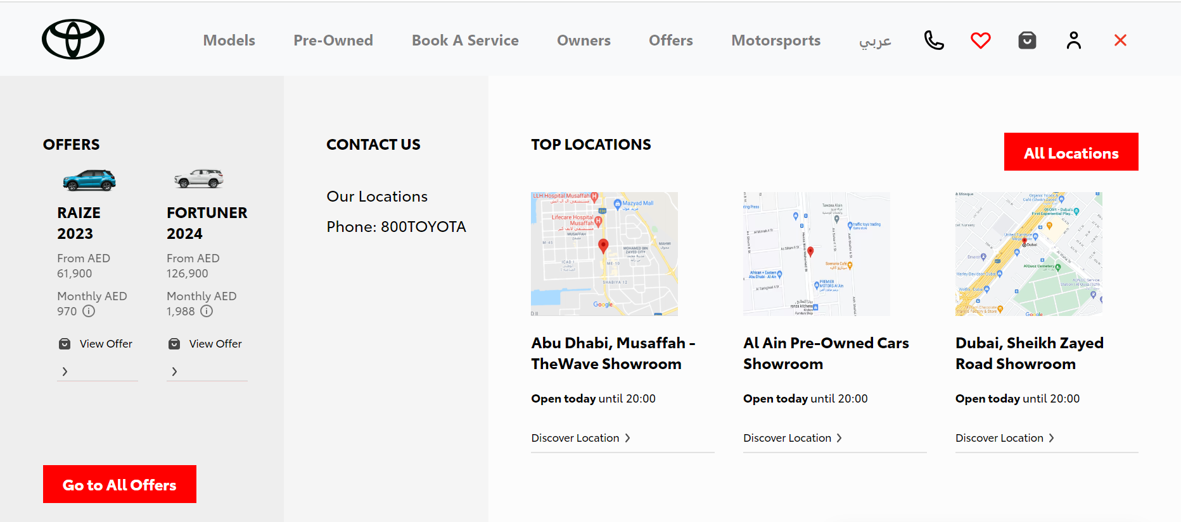
EXAMPLES OF LEAD SOURCES

Slide 22
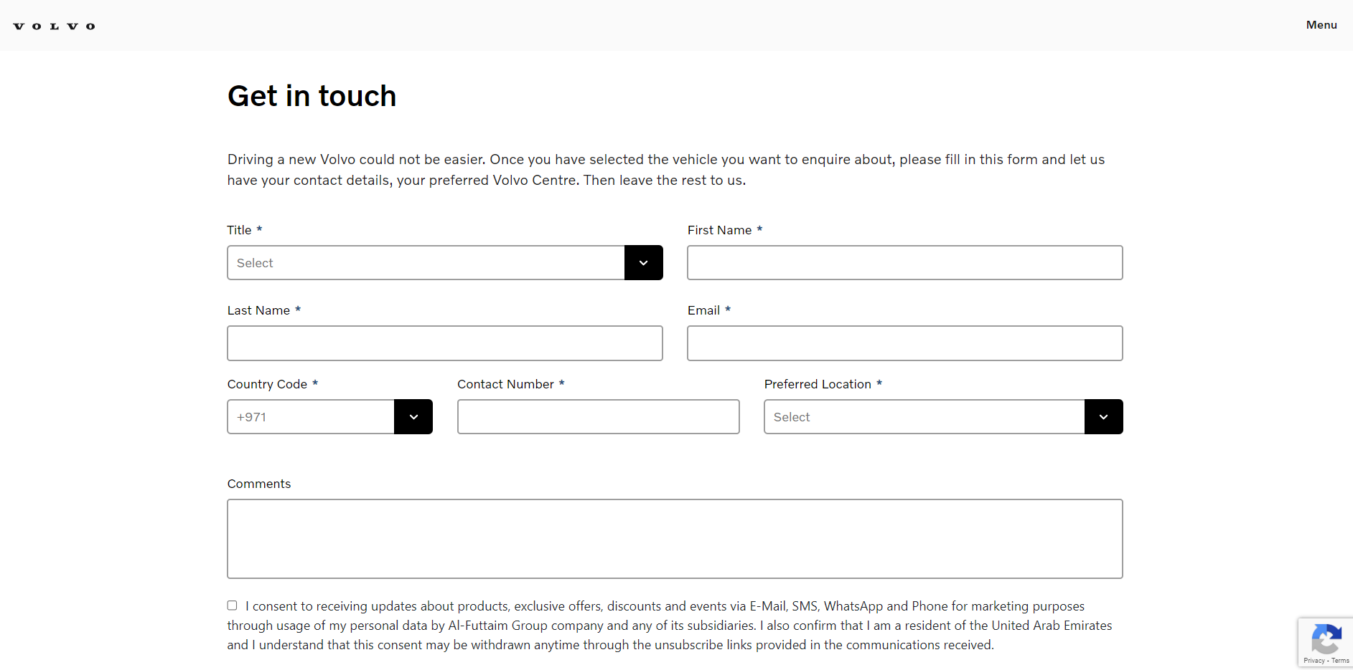
EXAMPLES OF LEAD SOURCES
Example 1

Slide 23
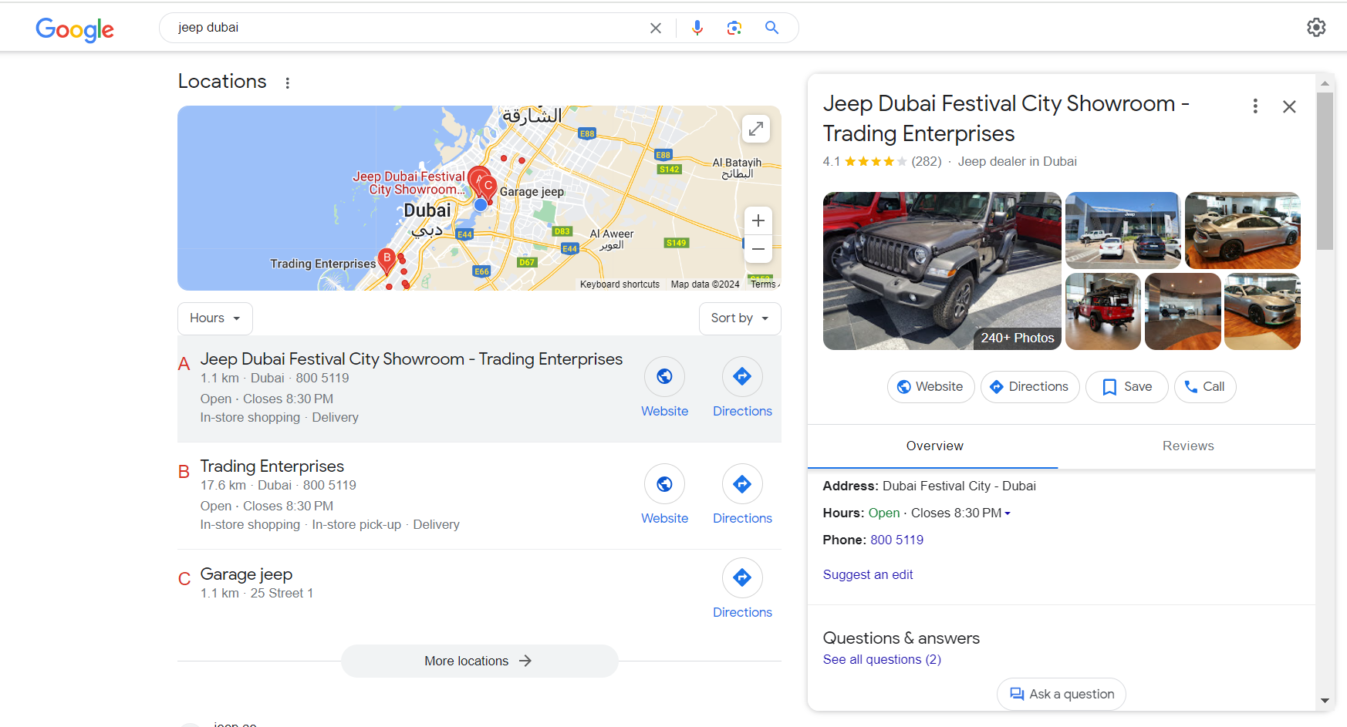
EXAMPLES OF LEAD SOURCES

Slide 24
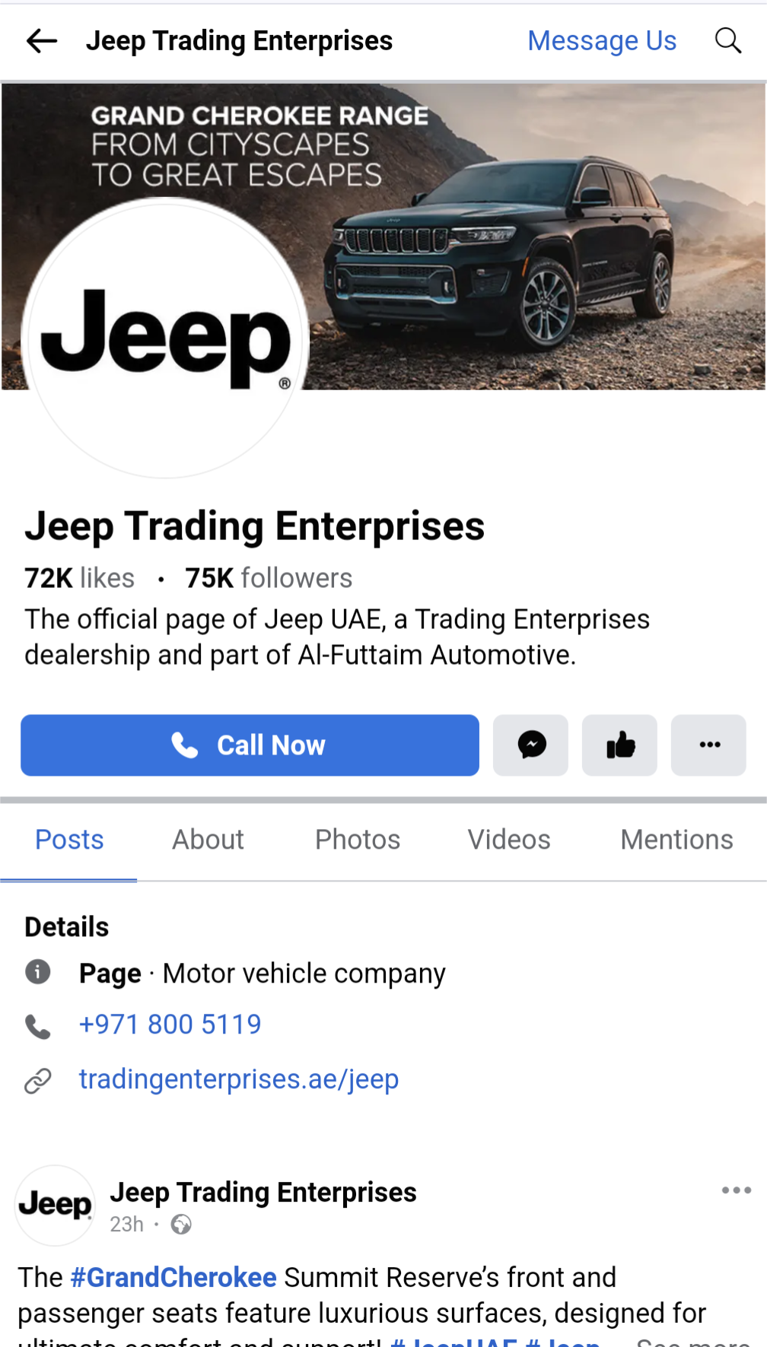
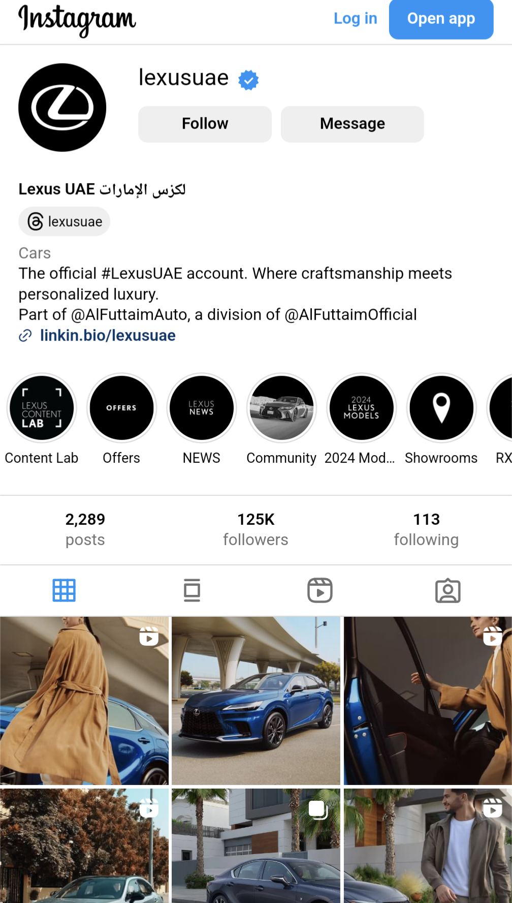
EXAMPLES OF LEAD SOURCES

Slide 25

TELL US ABOUT YOUR EXPERIENCES…
Reflect & share
What have been your experience when submitting leads?
Think about the last time you submitted a lead:
How long did you have to wait for a response?​
Did you get the information you requested?​
Were you able to make an informed decision?

Slide 26
3
SECTION
PROSPECTING

Slide 27
THOUGHTS ON PROSPECTING
Reflect
Take a minute and think about:
How can you expand your customer portfolio with new prospects?
List a few examples.
When was the last time you did actual prospecting?

Slide 28
4
SECTION
ENGAGING WITH LEADS & PROSPECTS

Slide 29



ACTIVITY 1: LEAD MANAGEMENT
List the types of questions that might be included in a Sales Lead or when interacting with a prospective customer. Compare the list with the list created by the members of your group.
Group of 4
5 minutes

Slide 30
TYPES OF QUESTIONS IN A SALES LEAD
Vehicle Specifics: Detailed information about available vehicle
Pricing: Including base prices, financing options, and promotions
Trade-In: Information about the trade-in process and how to get an assessment
Test Drive: Access to convenient and flexible test drive options
Financing Options: Information on financing plans, and monthly payments
After-Sales Services: Maintenance packages, warranty options, and post-purchase support.
Fuel Efficiency and Cost of Ownership: Maintenance costs and overall cost of ownership
Exclusive Offers and Incentives: Information about exclusive dealership offers and promotions

Slide 31
CHARACTERISTICS OF THE LEAD RESPONSE
FAST RESPONSE
(Timely)
Speed matters: Our response to leads MUST be timely.
Customers are looking for an almost instant response.
QUALITY RESPONSE
(Well planned)
A quality response will create trust and make it easier to build a relationship with customers.
CONVERT
(Appointment)
Having clear calls to action and next steps for the customer will help guide them through the sales process.

Slide 32

ATTRIBUTES OF QUALITY RESPONSE
Choose the right mode of response
Quick reply
Personalized & unique
Start a conversation

Slide 33
PICKING THE RIGHT MODE OF RESPONSE
If a phone number is provided:
Give the customer a call
Or use WhatsApp if notes as preferred method of communication
If a phone number is not provided:
Follow-up via email
Ask for phone number in follow-up response
Choose the right mode of response
Quick reply
Personalized & unique
Start a conversation

Slide 34
WHY IS IT IMPORTANT TO BE FAST?
Better Chances of Making a Sale
Happier Customers
Improve Brand Image
More Money in the Bank
Choose the right mode of response
Quick reply
Personalized & unique
Start a conversation
Notes:
Better Chances of Making a Sale: Quick replies mean you're more likely to turn a maybe into a yes.
Happier Customers: People love it when you answer fast. It shows you care and are ready to help.
Improve Brand Image: When you're quick to respond, people start thinking your brand is on the ball and reliable.
More Money in the Bank: The faster you respond, the more sales you're likely to make. And that means more profit.

Slide 35
QUALITY FOLLOW-UP EMAIL
Remember
Speed-to-lead increases the chances of first contact
A Harvard Business review concludes that:
Companies who try to contact potential customers within an hour of receiving a query are nearly 7x more likely to convert a lead as opposed to those who wait 60 minutes or more.

Slide 36
PERSONALIZED & UNIQUE
Choose the right mode of response
Include customer’s name
Thank the customer for the inquiry
Introduce yourself & dealership
Provide your contact details
Use autoreply only after office hours
Quick reply
Personalized & unique
Start a conversation

Slide 37
START A CONVERSATION
Product questions – specifications, features and finance/insurance questions.
Price questions – these can range from vague price questions, to requests for detailed pricing and trade-in.
Dealership questions – including stock enquiries, opening hours and test drives.
Choose the right mode of response
Quick reply
Personalized & unique
Start a conversation

Slide 38
5
SECTION
QUALITY FOLLOW-UP EMAIL

Slide 39
ACTIVITY 2: QUALITY FOLLOW-UP EMAIL
Mr. Kassem showed interest in the new vehicle through your dealer’s website. He sent an email asking about the following points:
1. Is the vehicle available? Or does it have to be ordered? 2. Can I trade-in my old vehicle? 3. Are there any service packages or extended warranty available with the new vehicle purchase Type an E-mail to reply to Mr. Kassem.
Complete Individually
10 minutes

Slide 40
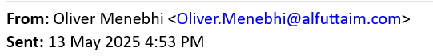
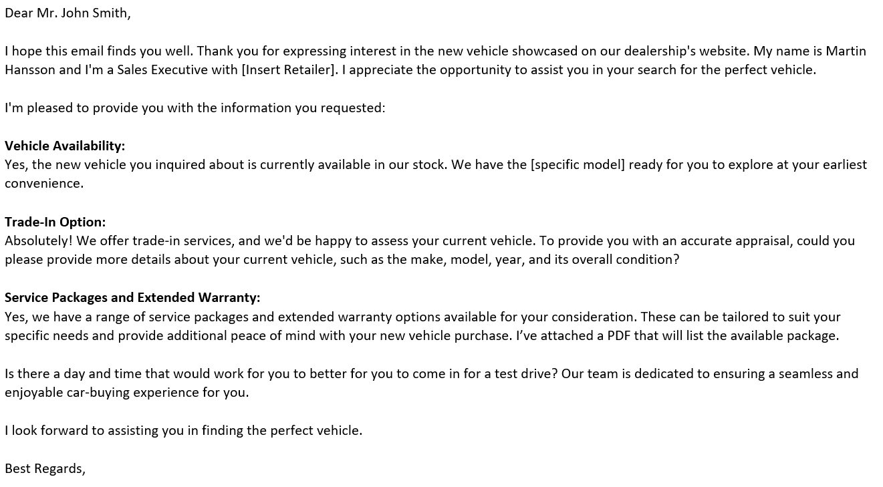
QUALITY RESPONSE - EMAIL

Slide 41
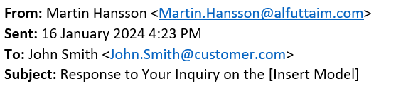
QUALITY RESPONSE - EMAIL
Email Subject Line:
A successful subject line has:
Clarity and Specificity
Urgency or Value Proposition
Personalization

Slide 42
QUALITY RESPONSE - EMAIL
Greeting & Introduction:
Use a professional greeting addressing the customer by their name
Introducing yourself and where you’re from
Convene excitement and that you’re excited to work with the customer

Slide 43
QUALITY RESPONSE - EMAIL
Answer and Ask Questions:
Answer all questions the customer might have
Ask for clarification if needed to ensure there is no confusion
Opportunity to ask qualifying questions if appropriate

Slide 44
QUALITY RESPONSE - EMAIL
Call to Action:
Offer the customer clear next steps
Ask for an appointment or a follow-up call as you see fit
It is Important to highlight to the customer that you are flexible and here to support them

Slide 45
QUALITY EMAIL RESPONSE TEMPLATE
REVIEW
Appropriate descriptive subject line
Thanked them for their interest
Addressed prospective customers by name
Introduced yourself (Name, Position, Dealership)
Answered and/or addressed all questions
Spell and grammar check
Email can be read in 2 – 3 mins
Check

Slide 46
QUALITY FOLLOW-UP EMAIL
Remember
Before pressing send!
Put yourself in the shoes of the customer.
Does what you are about to send make sense to you, if not, it won’t make sense to the customer.
Use the checklist

Slide 47
6
SECTION
QUALITY FOLLOW-UP PHONE

Slide 48
ACTIVITY 3: QUALITY FOLLOW-UP PHONE
Your customer Mr. Mohammed bought a vehicle 3 years ago. You have checked with the Service Department, and his last visit was 2 months ago, and it was the 110,000 KM Service. You are requested to approach your prospect by phone to see if he’s in the market for a new vehicle.
Record a voice note to replicate what you would say when contacting this customer as a potential buyer
In Pairs
10 minutes

Slide 49
QUALITY RESPONSE BY PHONE
Greeting
Data verification
Confirm appointment
Build Rapport
Summary

Slide 50
QUALITY RESPONSE BY PHONE
Introduce yourself (Name, position, dealer name)
Ask the customer if this is a suitable time to have the call
Summarize the reason for the call and show appreciation for the customer interest in the brand/dealer
Greeting
Data verification
Confirm appointment
Build rapport
Summary

Slide 51
QUALITY RESPONSE BY PHONE
Name, Address, Email, Phone No.
If applicable - car of Interest (Model + MY)
Greeting
Data verification
Confirm appointment
Build rapport
Summary

Slide 52
QUALITY RESPONSE BY PHONE
Confirm that the pre-selected day and time for an appointment is correct.
If there’s a need to change the date/time – be flexible
Is it possible to do an at-home test drives
Greeting
Data verification
Confirm appointment
Build rapport
Summary

Slide 53
QUALITY RESPONSE BY PHONE
Answer and/or address any additional questions that might come up.
When possible, keep it brief.
Take note on any additional information the customer might mention.
Do they need help with directions to the showroom
Who else might be joining them for the appointment
Greeting
Data verification
Confirm appointment
Build rapport
Summary

Slide 54
QUALITY RESPONSE BY PHONE
Summarize all the agreements / booking / etc..
Thank the customer again for his time and interest
Follow-up with an email summary
Greeting
Data verification
Confirm appointment
Build rapport
Summary

Slide 55
QUALITY PHONE RESPONSE TEMPLATE
REVIEW
Preparation and review
Polite and professional tone
Active listening
Introduced yourself (Name, Position, Dealership)
Answered and/or addressed all questions
Take notes
Next Steps and clear follow-up plan
Check

Slide 56
QUALITY FOLLOW-UP TELEPHONE
Remember
Before pressing Call!
Put yourself in the shoes of the customer.
Does what you are about to say make sense to you, if not, it won’t make sense to the customer.
Use the checklist

Slide 57
7
SECTION
QUALITY FOLLOW-UP WHATSAPP

Slide 58
ACTIVITY 4: QUALITY RESPONSE WHATSAPP
You have received a lead from your website for Mr. Ali on a new SUV. In the notes of the leads Mr. Ali has added that he would prefer if communication takes place via WhatsApp.
Fill in the blanks and complete the responses to the questions asked by the customers on the next slide.
Complete on your own and share with your group when completed
10 minutes

Slide 59
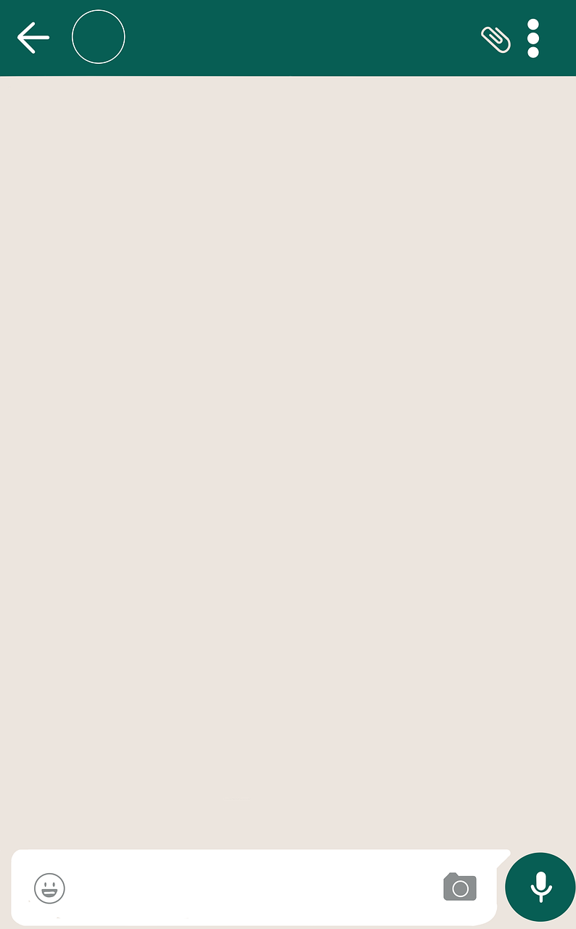
QUALITY RESPONSE BY WHATSAPP
I'm interested in the [Car Model] I saw on your website. Is it available and can you provide more information?
I'm also curious about the warranty options. Can you provide information on that?
My wife is worried about how her Apple Car Play will look on the infotainment system. Is that something to worry about?
Thank you, that’s helpful!
I will hopefully have time to
look at it in-person soon.

Slide 60
QUALITY RESPONSE BY WHATSAPP
Timely Responses
Clear and Concise Information
Visual Content
Personalization
Privacy and Security

Slide 61
QUALITY RESPONSE BY WHATSAPP
Respond promptly to customer inquiries on WhatsApp.
Timely communication is crucial in the automotive sales process, as customers are often actively researching and considering their options.
Aim to provide information and assistance in a timely manner to keep the customer engaged.
Timely Responses
Clear and Concise Information
Visual Content
Personalization
Privacy and Security

Slide 62
QUALITY RESPONSE BY WHATSAPP
Avoid overwhelming the customer with unnecessary information
Ensure that the details provided are comprehensive enough to address their questions
Timely Responses
Clear and Concise Information
Visual Content
Personalization
Privacy and Security

Slide 63
QUALITY RESPONSE BY WHATSAPP
Leverage the multimedia capabilities of WhatsApp by sharing photos and videos of the vehicle or dealership
Visual content can significantly enhance the customer's understanding of the product
It can also create a more engaging and informative conversation
Ensure that the visuals are high quality and showcase the key features of the vehicle
Timely Responses
Clear and Concise Information
Visual Content
Personalization
Privacy and Security

Slide 64
QUALITY RESPONSE BY WHATSAPP
Similar to email, tailor your communication to the individual customer's needs and preferences
Ask qualifying questions if needed to better understand their specific wants and needs.
This personalized approach helps build a stronger connection and increases the likelihood of a successful sale
Timely Responses
Clear and Concise Information
Visual Content
Personalization
Privacy and Security

Slide 65
QUALITY RESPONSE BY WHATSAPP
Respect customer privacy and adhere to data protection regulations
Avoid sharing sensitive information unless necessary
If more confidential information or transactions are required, consider having those discussions in person or via a secure communication channel
WhatsApp Communication should be done through C4C
Timely Responses
Clear and Concise Information
Visual Content
Personalization
Privacy and Security

Slide 66
QUALITY FOLLOW-UP
Remember
Identify the preferred communication channel
Communication becomes more effective, when we use customers preferred communication channel.
Doing so will enhance customer satisfaction, fostering long-term relationships and loyalty.

Slide 67
8
SECTION
THE APPOINTMENT

Slide 68
ACTIVITY 5: APPOINTMENT PREPARATION
How do you prepare for a first meeting appointment with a customer?
Complete on your own and share with your group when completed
5 minutes

Slide 69
COMPELLING REASONS FOR AN APPOINTMENT
Experience the vehicle in person
Test drive the vehicle
See the color options, packages, and trim levels
Meet you in person and put a face to the name
Start the paperwork
Evaluate trade-in

Slide 70
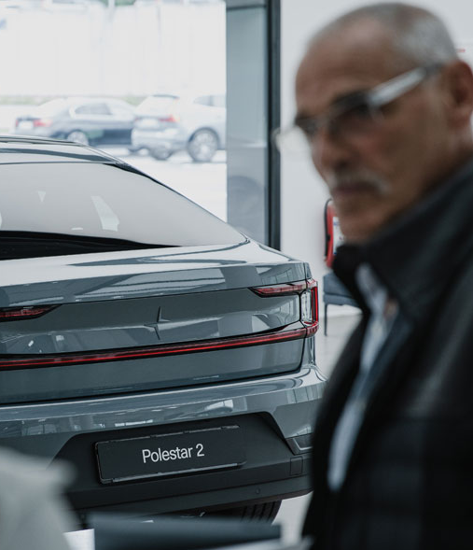
COMMON CUSTOMERS CONCERNS
I will not get what I asked for.
The vehicle will be different than the one we discussed.
I will not like the vehicle when I drive it.
The Colors look different on the web.
There will be surprise extra charges at the dealership.
The salesperson will not keep the promises.
We interact differently in-person than you did by e-mail or phone
Unexpected surprises
Push them to change their desired vehicle

Slide 71
9
Section
THE FIRST MEETING

Slide 72

THE FIRST MEETING
Welcome the customer to the dealership in a professional and approachable manner
Ensure that the customer’s information is correct in C4C and updated if needed
Offer refreshments if available
Show them to either the showroom seating area, your desk, or products as appropriate
Give the customer your name and make sure you get theirs
Have notes prepared on what’s previously been discussed with the customer or any questions you might have
Offer help and advice as required
Build rapport with the customer

Slide 73
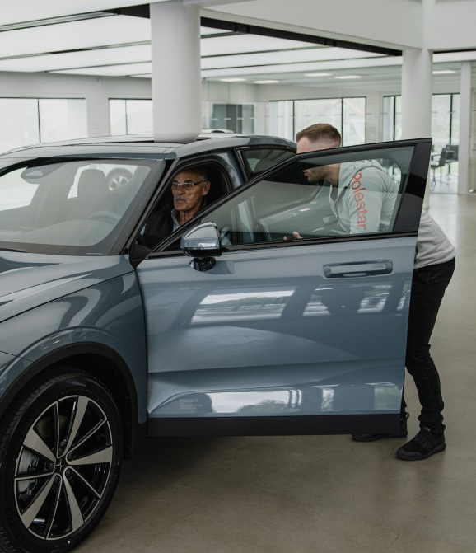
WHAT IS RAPPORT
Ensure your message is relevant and appealing
Establish common ground
Sound enthused and interested
Speak their language
Remain professional throughout
Be calm and relaxed
Ask Open Questions
Listen
Be conscious of body language
Mirror your customer’s body language
Appropriate eye contact
Smile!
Use their name

Slide 74

WHY IS GREETING CRITICAL IN THE FIRST MEETING?
First Impression Lasts
You are Selling yourself, your dealership, the experience and lastly the car
You want to get the customer comfortable
Building Trust & Rapport

Slide 75

GREETING MADE EASY
Professional Appearance
Personal hygiene
Outfit
Smile
Body Language
Introduction statement
Summarize the previous call
Manage Expectation

Slide 76
GREETING MADE EASY
Professional Appearance
Thank the customer for their interest in your product
Introduce yourself (Name and Job title)
Don’t forget your smile
Introduction statement
Summarize the previous call
Manage Expectation

Slide 77
GREETING MADE EASY
Professional Appearance
Summarize what you agreed on during your previous call (Model of Interest, Current Vehicle, etc.)
Introduction statement
Summarize the previous call
Manage Expectation

Slide 78
GREETING MADE EASY
Professional Appearance
Briefly describe to your customer what is going to happen (the process that you will take him/her through)
Introduction statement
Summarize the previous call
Manage Expectation

Slide 79
WHAT DEFINES EXCEPTIONAL EXPERIENCE
Personalized, tailored to that customer’s needs and interests
Attentive, listening, exploring preferences
Detailed with thoughtful touches
Consultative, relationship-based
Endures over time
Transparent, honest, credible

Slide 80
QUALIFICATION

Slide 81

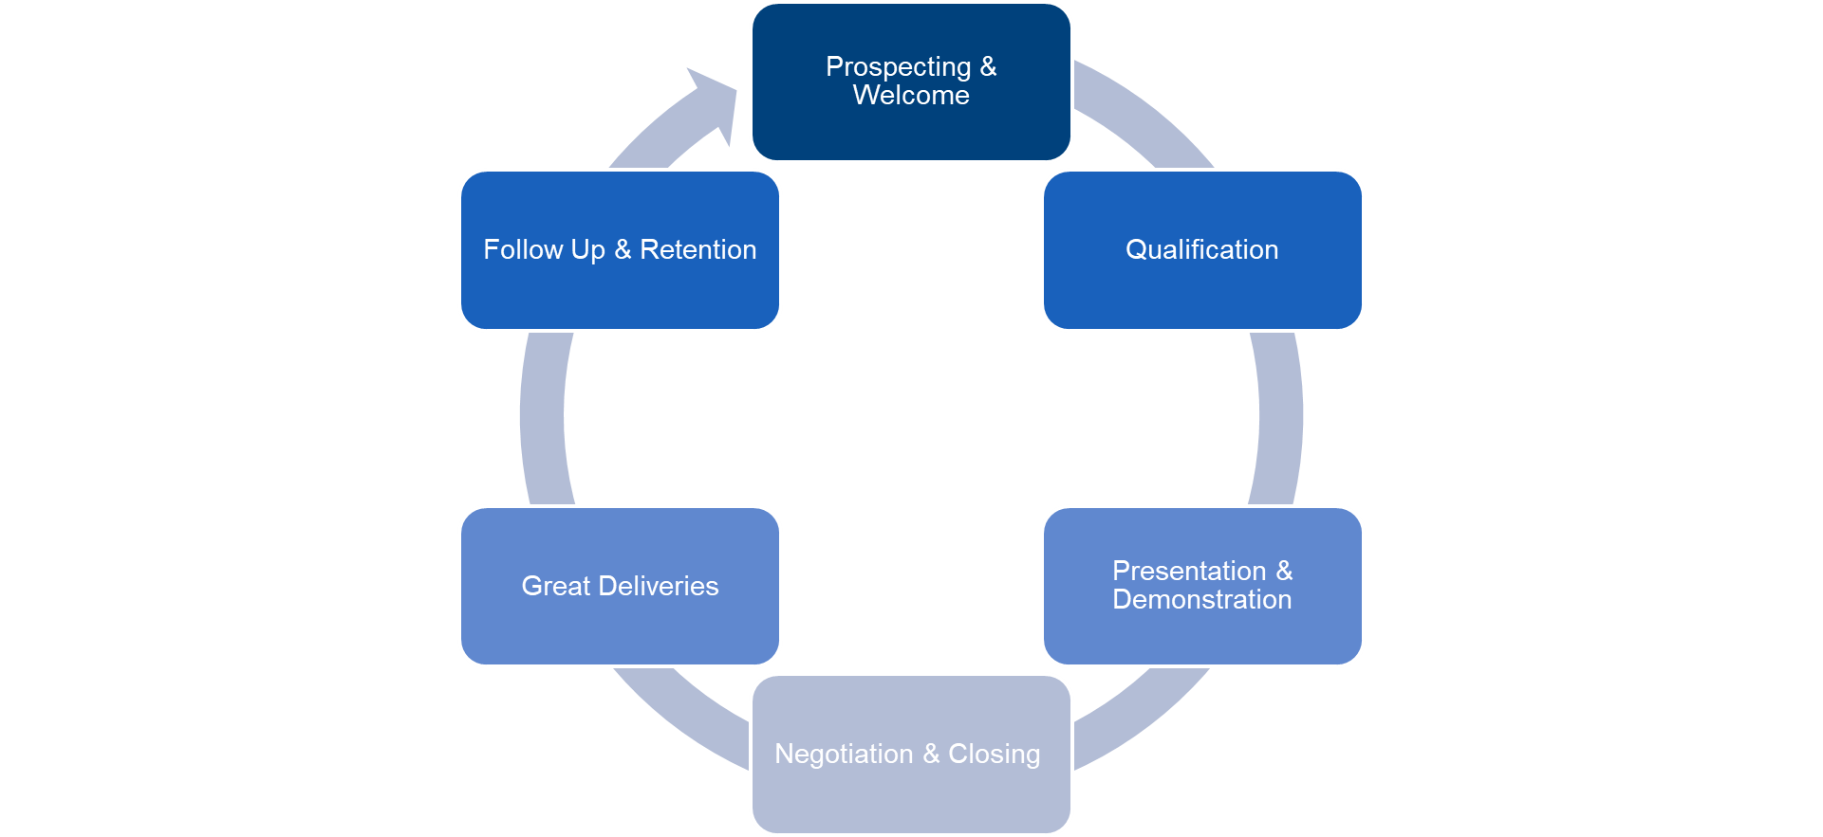
WHAT WILL BE YOUR NEXT STEPS?

Slide 82
10
Section
QUALITY NEEDS ASSESSMENT

Slide 83

QUALITY NEEDS ASSESSMENT
What should be your main goal from the customer discovery process?

Slide 84
QUALITY NEEDS ASSESSMENT
What should be your main goal from the customer discovery process?
Collect as much information as possible
Customer MUST feel they are being listened to

Slide 85

QUALITY NEEDS ASSESSMENT
Confirm & Clarify Customer
Research
Determine where customer is at in the buying process through questions and conversation
Understand and clarify customer research
Conduct Needs Analysis
Confirm Vehicle Selection
Manage Expectation

Slide 86
QUALITY NEEDS ASSESSMENT
Confirm & Clarify Customer
Research
Utilize resources to assist customers in defining which vehicles, features or options they are interested in
Understand and clarify customer’s primary buyer motives
Conduct Needs Analysis
Confirm Vehicle Selection
Manage Expectation

Slide 87
QUALITY NEEDS ASSESSMENT
Confirm & Clarify Customer
Research
Review customer needs and wants
Provide vehicle recommendation based on information provided by the customer
Confirm vehicle availability and/or make alternate recommendations
Conduct Needs Analysis
Confirm Vehicle Selection
Manage Expectation

Slide 88








WHY DO PEOPLE BUY CARS?
SPECIT

Slide 89
PRODUCT PRESENTATION
S
Safety & Security
P
Performance
E
Economy, Environment, Electrification
SPECIT
C
Comfort & Convenience
I
Image
T
Technology

Slide 90
ACTIVITY 1: THE WISH-LIST ACTIVITY
Imagine you have the perfect customer in front of you that would answer any questions in honesty and in detail that you would ask them.
Create a wish list of all the questions that you would want to ask? Consider SPECIT it as well.
Groups – x2 Associates (pairs)
5 minutes

Slide 91

QUALITY NEEDS ASSESSMENT
WISH-LIST activity, debrief on questions that could be asked
Influencers
How many kids?
The main Driver?
How many passengers?
Decision maker?
Needs
Budget
Competition

Slide 92
QUALITY NEEDS ASSESSMENT
WISH-LIST activity, debrief on questions that could be asked
Influencers
Current Vehicle?
Type of usage?
Reasons to buy?
Travel patterns?
Cargo/Luggage?
Preferred colors?
Favorite sport?
Specific features?
Needs
Budget
Competition

Slide 93
QUALITY NEEDS ASSESSMENT
WISH-LIST activity, debrief on questions that could be asked
Influencers
Budget?
Payment method?
Trade-in?
Timeline?
Needs
Budget
Competition

Slide 94
QUALITY NEEDS ASSESSMENT
WISH-LIST activity, debrief on questions that could be asked
Influencers
Previous search?
Is it the 1st visit?
Any shortlisted vehicles (brands/models)?
Competition offers?
What you like in other brands?
Needs
Budget
Competition

Slide 95

QUALITY NEEDS ASSESSMENT
What are some good examples for “Qualifying Questions”?
May I ask why you are thinking about buying a new car?
Are there any specific brands or models you are interested in? Why?
What is your current vehicle if I may ask?
What features does your current vehicle have that you would still like to have in your new one?
What do you dislike about your current vehicle?
Notes:
Ask
What are some good examples for “Qualifying Questions”?
Do
Lead a discussion to find some good qualifying questions
Animation ------------- SAY
These are some examples for qualifying questions we can use to help us with our “Customers’ needs analysis” step

Slide 96
QUALITY NEEDS ASSESSMENT
What are some good examples for “Qualifying Questions”?
What are the top 3 things you’d love to see in your new vehicle?
Will you be trading in your current vehicle? We can evaluate it for you on our C4C system.
Who is going to drive the vehicle most of the time and for what purpose (business, pleasure, family, off-road, etc.)?
What is your timeline? (Buying ASAP vs. browsing and waiting)
Are you planning to pay cash or finance the vehicle?
Did you finance your last vehicle? What was your monthly payment?
Notes:
Ask
What are some good examples for “Qualifying Questions”?
Do
Lead a discussion to find some good qualifying questions
Animation ------------- SAY
These are some examples for qualifying questions we can use to help us with our “Customers’ needs analysis” step

Slide 97
11
ADAPTING CONSULTATIVE APPROACH

Slide 98

ADAPTING CONSULTATIVE APPROACH
Ask the right questions (Qualifying Questions)
Active Listening
Building Rapport
Responsive

Slide 99
ADAPTING CONSULTATIVE APPROACH
Ask the right questions (Qualifying Questions)
Open-ended Questions
How would you describe a life in the day of your car?
Closed-ended Questions
Are you happy with your experience with us?
Clarifying Questions
Could you provide more details on how you would like the custom paint to appear on your vehicle?
Notes:
Open-ended
An open-ended question is designed to encourage a full
meaningful answer using the customer’s own knowledge and/or feelings. Open-ended questions are used when you need the customer to provide you with all the information in a form of story. Usually customers will start talking and provide you with many information, where some of these information (not all) are useful to you
Closed-ended
Close-ended questions are those which can be answered by a simple 'yes' or 'no’ and we usually use them to confirm something.
Clarifying Questions
These are simple questions of fact. They clarify the dilemma and provide the nuts and bolts so that the Sales Consultants can ask good probing questions and provide useful feedback later.
Clarifying questions have brief, factual answers, and don't provide any new 'food for thought'.

Slide 100
ACTIVITY: THE WITCHES OF GLUM
When instructed, you will be told a story, your task is to actively listen and respond. After the story is complete the trainer will ask you some questions – lets see who can get the most questions correct
Individual Exercise
10 minutes

Slide 101

ADAPTING CONSULTATIVE APPROACH
Active Listening
What does active listening mean?

Slide 102
ADAPTING CONSULTATIVE APPROACH
Active Listening
What does active listening mean?
Good question is useless if you don’t listen to the answer
Customer want to be heard
Build trust
Notes:
Good questions are valuable only if you are listening intently to what the customer tells you
Customers want to know that they are being heard, that you are, in fact, considering what they want, not what you “think” they want
Also it builds trust between the customer and yourself.

Slide 103
ADAPTING CONSULTATIVE APPROACH
Active Listening
What does active listening mean?
Asking clarifying questions: “Just so I understand what you’re saying…”
Restating what the customer just said to confirm your understanding
Ask more questions to get a clearer understanding
Good non-verbal signals are also helpful, including making eye-contact, nodding and showing that you are listening
Notes:
Good questions are valuable only if you are listening intently to what the customer tells you
Customers want to know that they are being heard, that you are, in fact, considering what they want, not what you “think” they want
Also it builds trust between the customer and yourself.

Slide 104

ADAPTING CONSULTATIVE APPROACH
Building Rapport
Barriers to Rapport building
One way communication
Not allowing the customer time to reciprocate the conversation
Level of knowledge
Talking about things at a level too high (or too low) for the customer
Poor listening skills
Allowing things to distract us from listening properly to customers
Prejudgments
Notes:
Alongside becoming a Trusted Advisor in the eyes of the customers, it is also important to build rapport. The following are things to avoid that make building rapport more difficult.
If all the above are avoided, it becomes easier to build rapport – an trust your customer dealings.
Key Objective: Earn the Status of Trusted Advisor
Along the sales journey, the Sales Executive should aim to earn the status of Trusted Advisor with their customers. This may be done at any time throughout the process, and is especially important when initially greeting customers in the showroom.

Slide 105

ADAPTING CONSULTATIVE APPROACH
4. Responsive
Meet the customer where they are in the process
Be flexible to adapt the process to the customer time
Notes:
SAY
Finally, our customer needs analysis should be responsive to what the customer tells us. That means that rather than a rigid process, we work to meet the customer where they are in the process:
As we have discussed, they may have done substantial research online and have a specific model in mind
They may be inside a display vehicle on the showroom floor when you meet them and are clearly interested in what they are looking at
They may have only 20 minutes and want to go straight to the test drive
Let the customer guide the process — the questions and conversation can take place throughout
ASK:
How have you adapted the traditional sales process to accommodate customers:
Short on time?
Interested in going directly to a test drive?
Other examples?
Discuss each example and highlight how it benefited the customer and helped build a positive working relationship

Slide 106


CONCLUSION
In today’s session we have discussed…
The Importance and benefits of following the sales process
Leads Vs Prospects and the value they add to performance
Best practice communications techniques for leads/prospects
The importance of the first meeting and a good impression
The correct steps for matching customer needs to products
The consultative approach in needs analysis
How to begin matching needs to a product

Slide 107
QUESTIONS

Slide 108
NEXT STEPS...
First Gear - Sales Induction & Probation
IMI Sales Process Module 1 & 2
IMI Sales Process Module 3 & 4
Product eLearning
IMI Sales Process Module 5 (Half day)
On the job training
Advanced Customer Communications
Coaching 1-2-1’s
IMI Sales Accreditation Assessment (In-Branch)
IMI Sales Accreditation Awards Ceremony

Slide 109
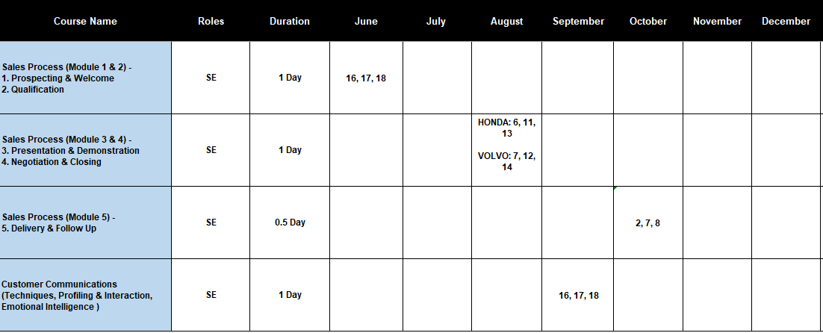
YOUR NEXT COURSE DATE

Slide 110
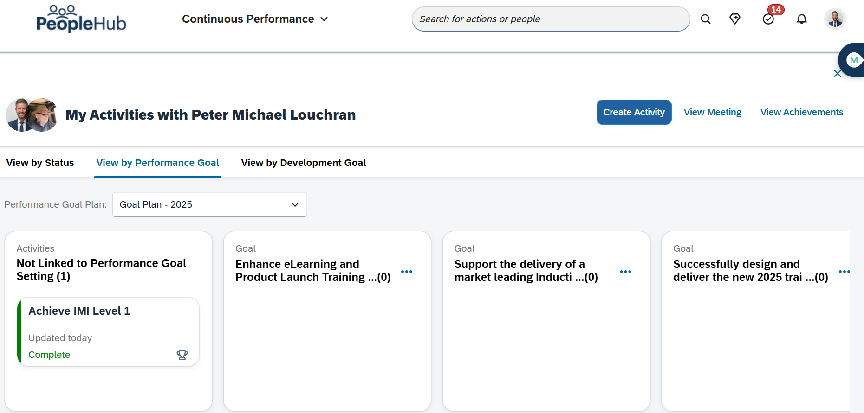
NEXT STEPS – HAVE YOU SET AN IDP?

Slide 111
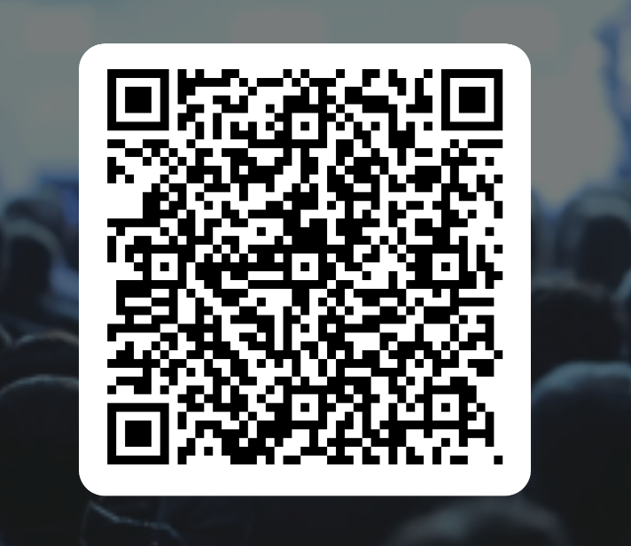
THANK YOU!

